Slide 1
Image Encryption Using Matrix Transmutation
Submitted BY:
Mahendra kumar (2012ecs53)
Rahul Mishra (2012ecs01)
Sumit jha (2012ecs11)

Slide 2
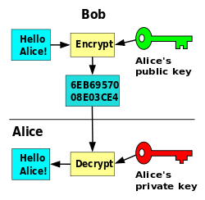
Cryptography
It is usually referred to as "the study of secret", while nowadays is most attached to the definition of encryption. Encryption is the process of converting plain text "unhidden" to a cryptic text "hidden" to secure it against data thieves. This process has another part where cryptic text needs to be decrypted on the other end to be understood. Figure given below shows the simple flow of commonly used encryption algorithms.

Slide 3
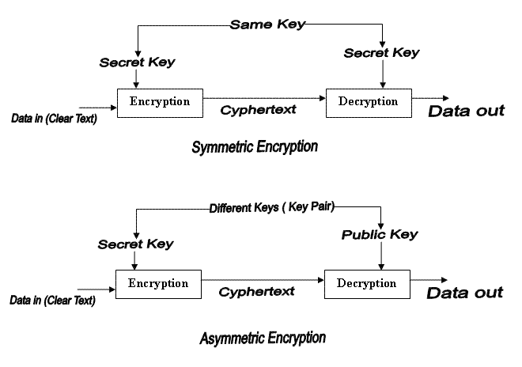
Types of Cryptography
Private key

Slide 4
Cryptanalysis: Types of Attacks

Slide 5
Linear Cryptanalysis
Another recent Development
Also a Statistical Method
Based on finding linear approximations to model the transformation of DES.
Can Attack DES with 2⁴⁷ plaintexts , still in practice infeasible

Slide 6
Differential Cryptanalysis
A statistical attack Feistel Ciphers
Uses cipher structure not previously used
Design of S-P networks has output of function f influenced by both input & key
Hence cannot trace back through cipher without knowing values of the key
Differential Cryptanalysis compares two related pairs of encryptions

Slide 7
Brute Force Attack
If it is known that a given cipher text is a Caesar cipher , then a brute force cryptanalysis is easily performed
Simply try all the 25 possible keys.
Yes. Trying all possible combination to crack the encrypted Code.

Slide 8
Statistical Attack
It's an attack that exploits statistical weaknesses in a targeted algorithm. For example, if a random number generator is used in the encryption process, and the attacker understands how the generator works, that knowledge can be exploited to crack an algorithm.

Slide 9
DATA FLOW DIAGRAMs

Slide 10
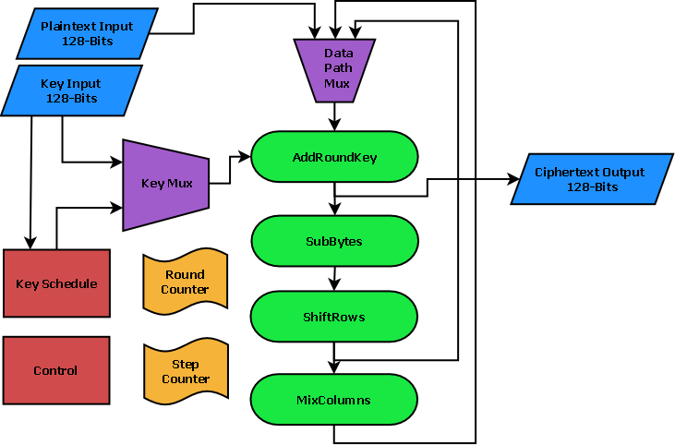
AES Data flow diagram

Slide 11
DES Data Flow Diagram

Slide 12
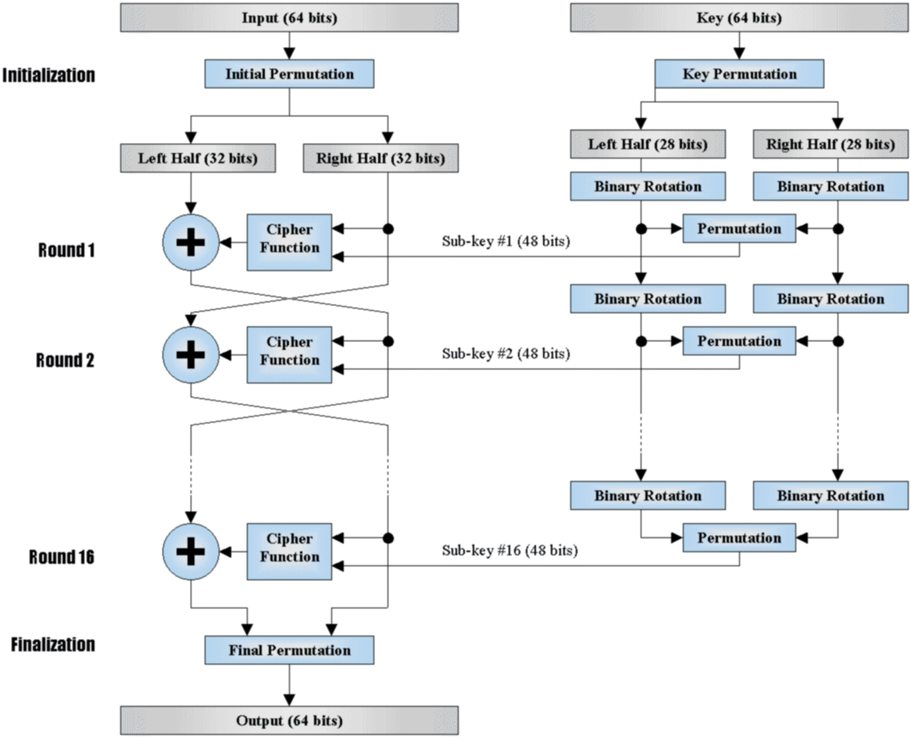

Slide 13
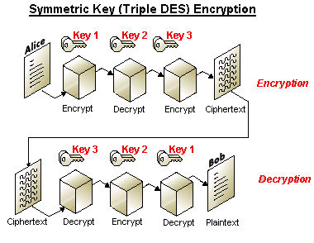
3DES Data Flow Diagram

Slide 14
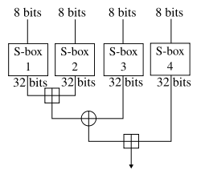
Blowfish Data Flow Diagram

Slide 15
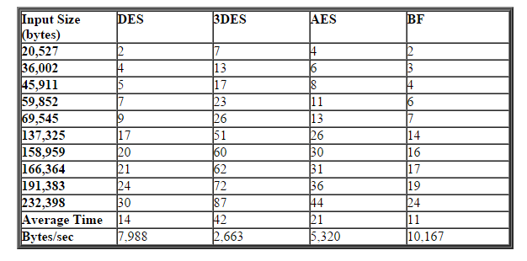
Comparison of Various Encryption Schemes

Slide 16
Image Encryption Using Blowfish Algorithm Along with Matrix Transmutation

Slide 17
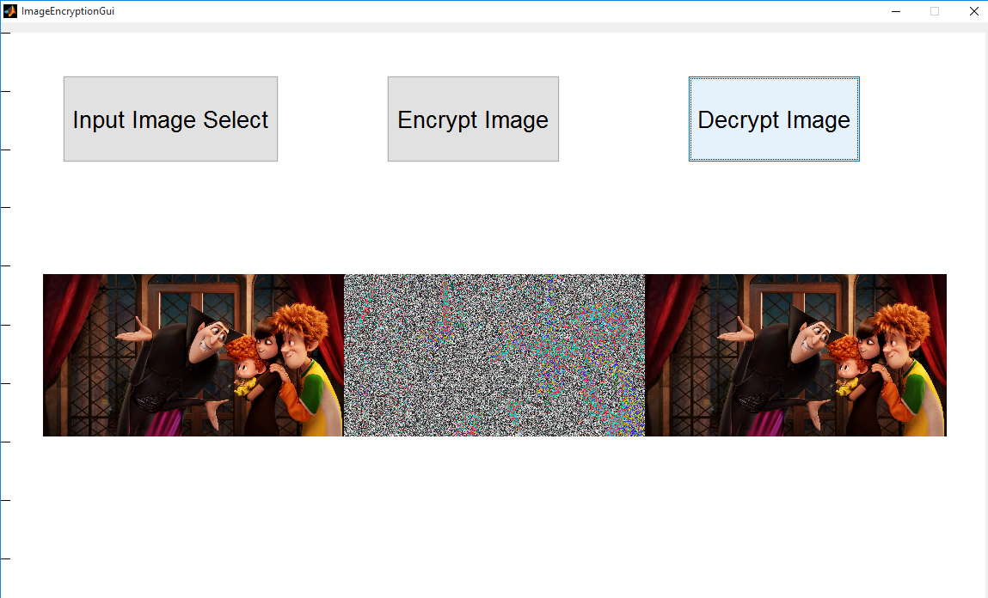
Fig. Image Encryption using Blowfish Algorithm

Slide 18
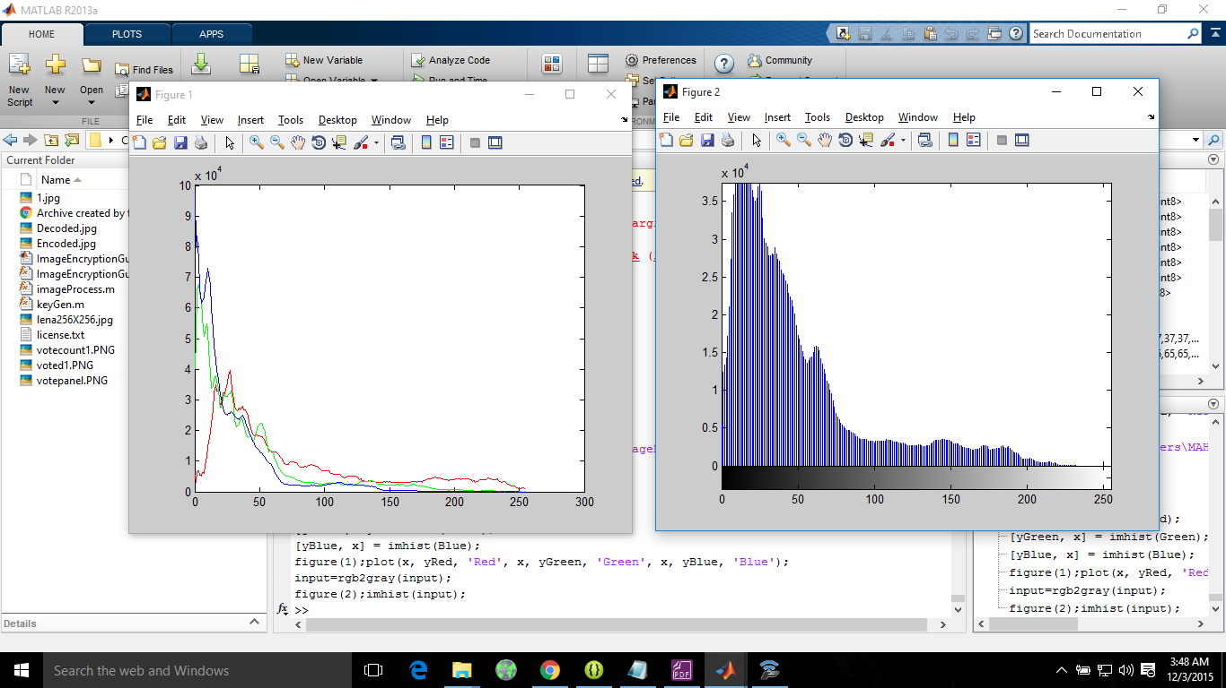
Fig. Histogram of Original Image

Slide 19
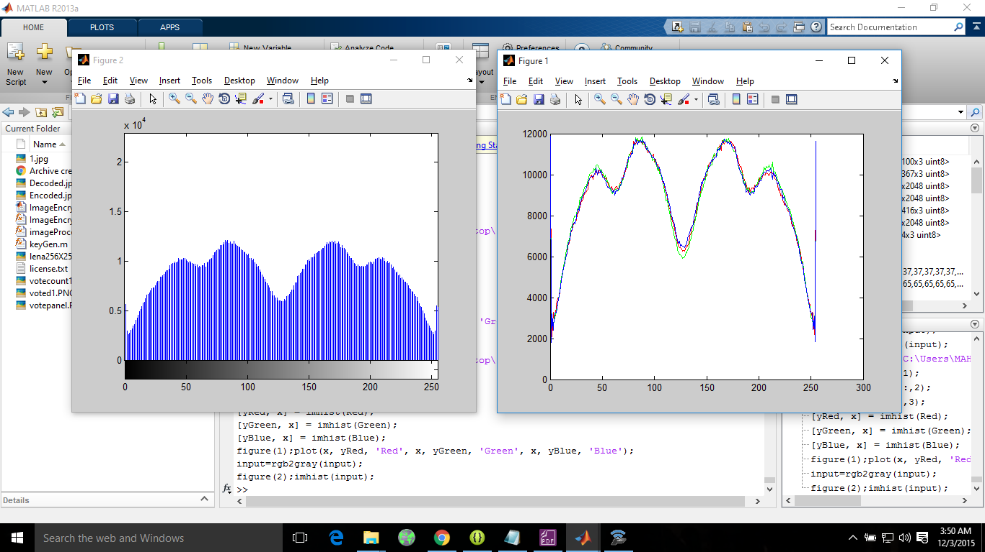
Fig. Histogram of Encoded Image (Applying Blowfish Algorithm)

Slide 20
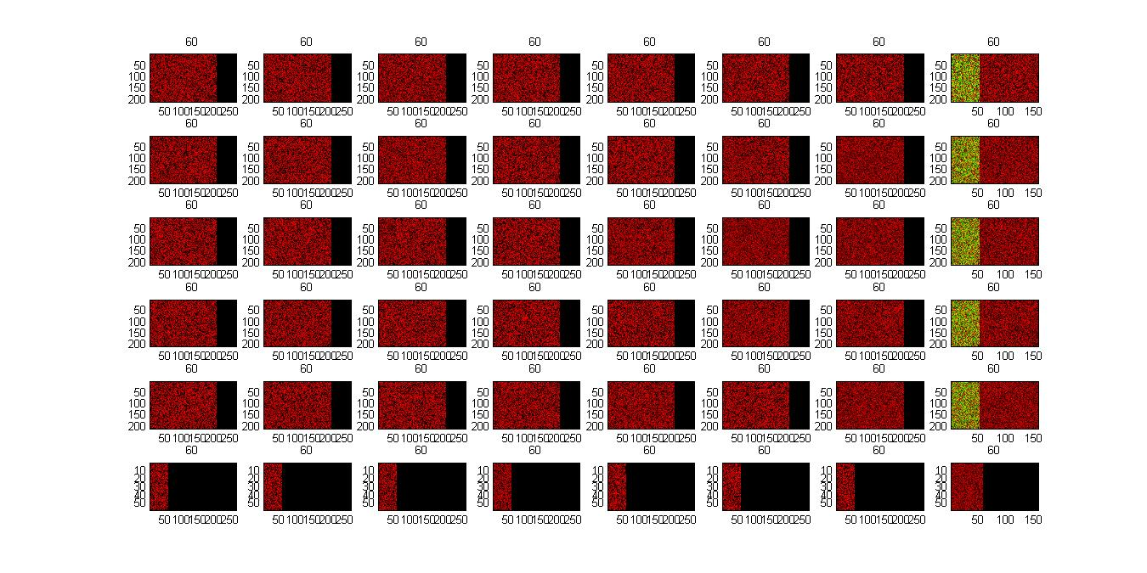
Fig. Block formation for Encoded Image (Applying Matrix Transmutation Algorithm over Encoded Image obtained by Blowfish Algorithm)

Slide 21
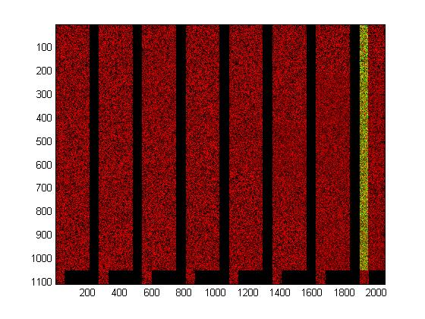
Fig. Encoded Image Applying Matrix Transmutation Algorithm over Encoded Image Obtained by Blowfish Algorithm

Slide 22
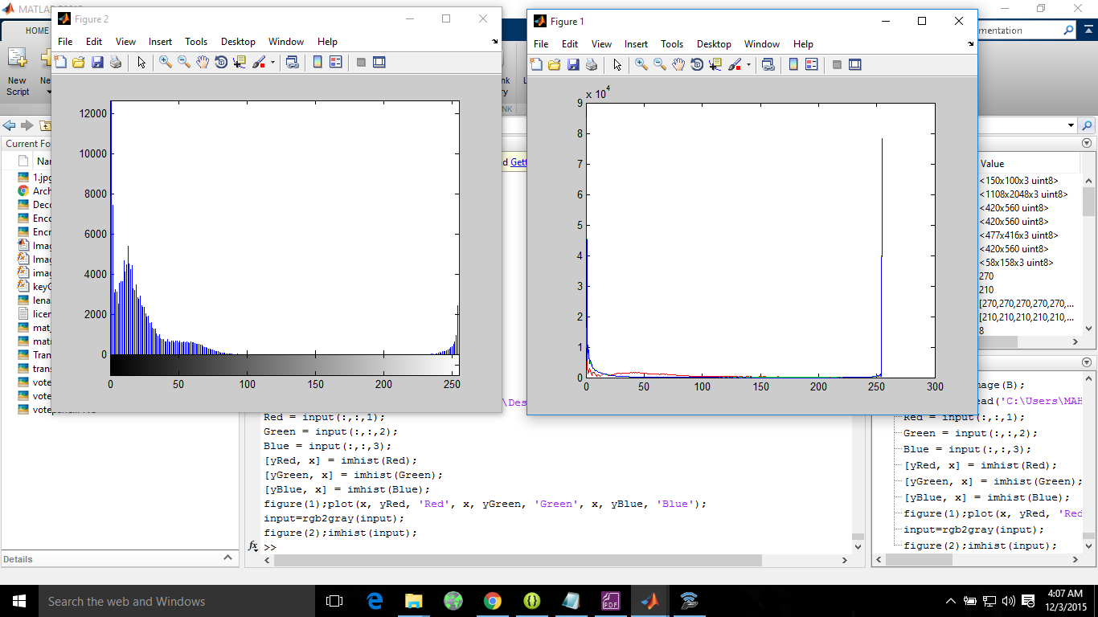
Fig. Histogram of Encoded Image (Applying Matrix Transmutation Algorithm over Encoded Image Obtained by Blowfish Algorithm)

Slide 23
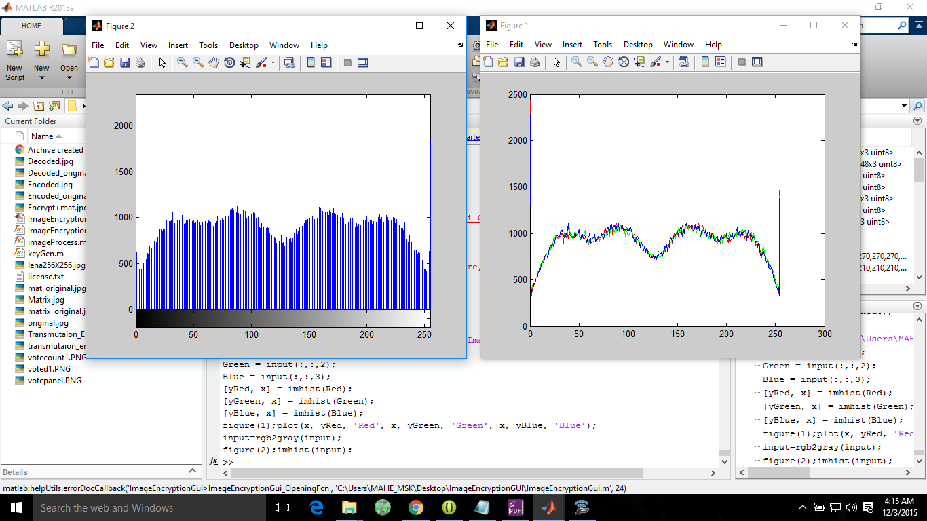
Fig. Histogram of Encoded Image (Applying Blowfish Algorithm over Encoded Image Obtained by Matrix Transmutation Algorithm

Slide 24
Fig: Pixel Distribution over Grayscale (0-250) for given Image
Algorithm Used | Pixel Variation for max and min value(Approx.) | Average number of pixel Distribution
Original Image | 9000 | > 10000
Blowfish Only | 7500 | 1000 - 5000
Matrix Transmutation Only | 7000 | < 1000
Matrix Transmutation over Blowfish | 6000 | < 500
Blowfish Over Matrix Transmutation | 2100 | 500 - 1000

Slide 25
CONCLUSION
From the above results we can conclude that applying blowfish over Matrix Transmutation or vice-versa results in good encryption with large confusion and diffusion value.
Applying Matrix Transmutation or Blowfish algorithm one at a time on the original image is not sufficient as both are vulnerable to statistical attack.
When applying Matrix Transmutation most of the pixels lie on the extremes values of Grayscale but on an average, number of pixels remains constant so more resistant to statistical Attacks than Blowfish.
Whether we apply Matrix Transmutation over Blowfish or Blowfish over Matrix Transmutation both give us approximately the same result.
Out of the various encryption schemes DES, AES, 3DES and Blowfish discussed Blowfish Algorithm has the highest efficiency

Slide 26
FUTURE WORK
Applying Image encryption by using Henon mapping system to diffuse the correlation between crypto-image and plain-image in the Matrix Transmutation Algorithm along with the applied one.
To Apply Matrix Transmutation in between the various rounds of blowfish Algorithm to check the efficiency.
Apply Matrix Transmutation along with DES, 3DES, AES and then doing comparison.

Slide 27
THANK YOU
Any Queries??

